Slide 1

Compressed Video Segmentation
Chandrakishor Singh - MIT2021117

Slide 2
Presentation Outline
Features for segmentation in Compressed Domain
Using Motion vectors in Segmentation
Confidence Measure
Conclusion

Slide 3
Features for Segmentation in Compressed Domain

Slide 4
Compressed Domain: Definition
Compressed Domain refers to video compression techniques that exploits Spatial and Temporal Redundancy using
DCT & Quantization
Motion Compensation
Examples include MPEG-1/-2/-4, H.261 and H.263

Slide 5
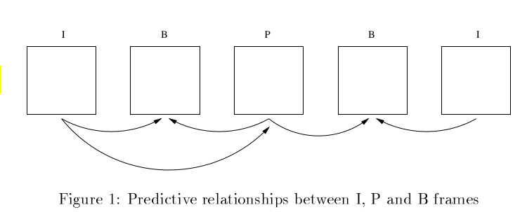
Compressed Domain
Operations in compressed domain involves processing of
DCT coefficients(from I-macroblocks)
Motion Vectors(from P-/B-macroblocks)

Slide 6
Compressed Domain: Parsing
Unlike pixel domain, operations in the compressed domain do not require the input bitstream to be decoded
Instead, they are parsed.

Slide 7
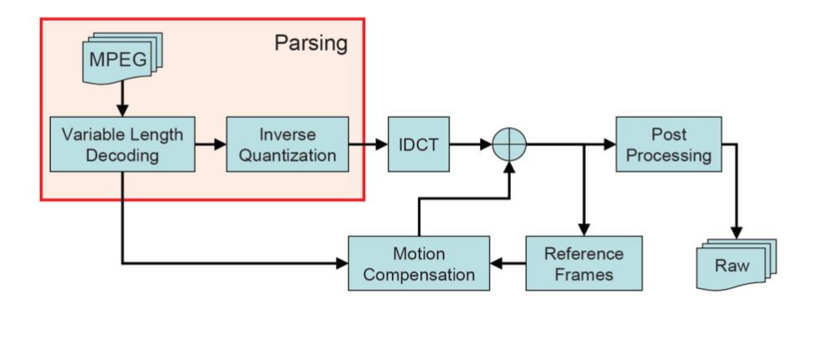
Compressed Domain: Parsing

Slide 8
Features for segmentation
After parsing, we have
DCT coefficients(from I-macroblocks)
Motion Vectors(from P-/B-macroblocks)
Which corresponds to
Frequencies of texture change
Motion of the macroblock

Slide 9
Using Motion Vectors in Segmentation

Slide 10
Acquiring Dense Motion Field
Many video object segmentation methods attempt to acquire a dense smooth motion field in order to create object masks
For this end spatial interpolation and motion accumulation are employed

Slide 11
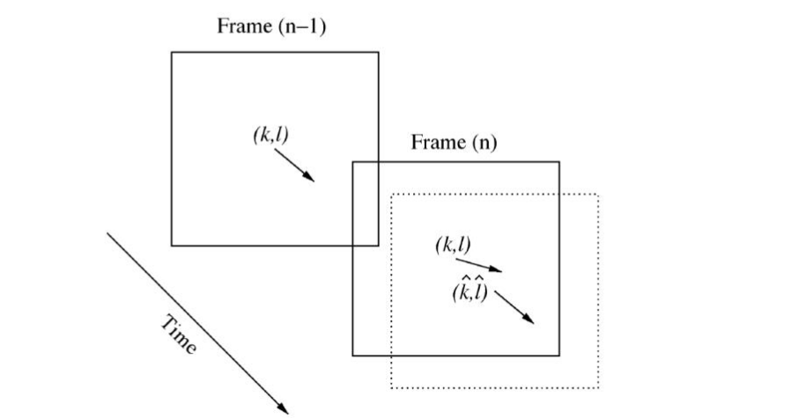
Motion Accumulation

Slide 12
Motion Accumulation
Due to different magnitudes and signs of motion vectors, the obtained MVs are normalized, e.g., MVs in B-macroblocks would have their signs reversed
Filtering is applied to remove non-uniform MV and smooth the motion field

Slide 13
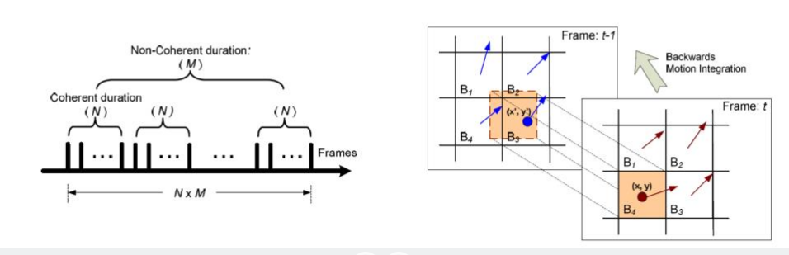
Motion Accumulation
Chen and Bajic [chen2009] employs MV integration block-wise and pixel-wise to enhance the Motion Field

Slide 14
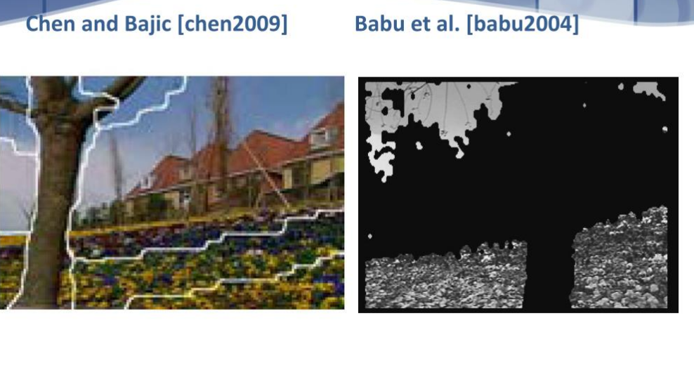
Motion Accumulation

Slide 15
Porikli’s Investigation
The Compressed Domain segmentation system published by Porikli’s experimented the effect of DCT coefficients and MV on segmentation performance
The DCT parameters of the I-frame
Low vertical and horizontal frequency values
A spatial energy term
Aggregated motion flow of the corresponding macroblock

Slide 16
Porikli’s Investigation(Cont.)
They create a frequency temporal data structure for each macroblock with the features and perform volume segmentation
Their results show that using DCT terms in segmentation and using MV in the hierarchical clustering, on average gives better results.

Slide 17
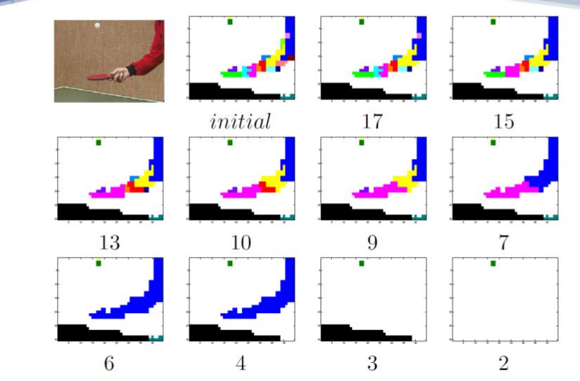
Porikli’s Investigation(Cont.)

Slide 18
Porikli’s Investigation(Cont.)
The Block Matching Process in the encoding stage looks only for the best match for a macroblock rather than object motion

Slide 19
Confidence Measure of Motion Vectors

Slide 20
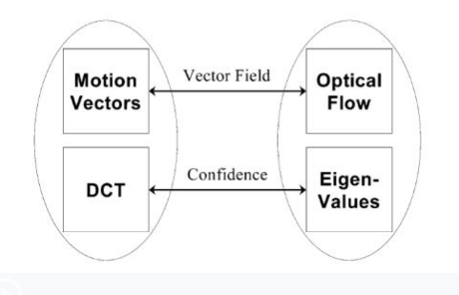
Approximating Optical Flow
Coimbra and Davies try to approximate Lucas-Kanade optical flow in MPEG-2 Compressed Domain

Slide 21
Confidence Measure
I-macroblock can be used as Confidence Measure
The confidence update step will have a 8x8 macroblock referencing a 16x16 image block in the I-frame and the confidence of the motion vector of the macroblock is the weighted average of confidence in the 16x16 window.

Slide 22
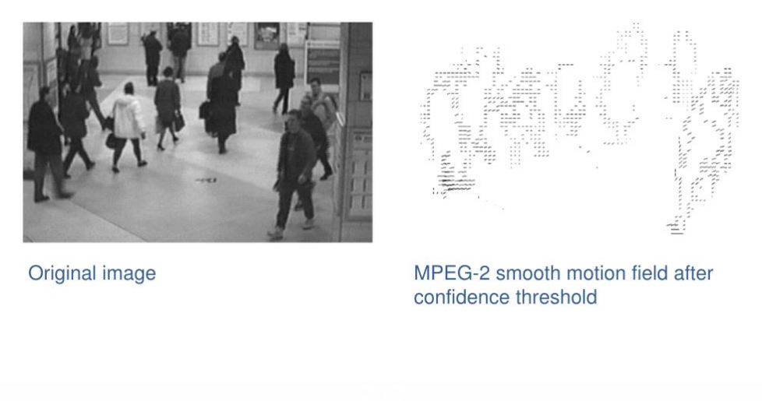
Confidence Measure(Cont.)

Slide 23
Conclusion

Slide 24
Conclusion
Due to block matching process, motion vectors in P-/B- frames do not necessarily relate to object motion
To ensure a motion vector is correlated to object motion, some sort of confidence measure is required
An alternative confidence measure is edge strength

Slide 25
Thank you

